Slide 1


CI/CD of Power Platform solutions & Branching strategies
MAPLE POWER 2020
NOVEMBER 21ST, 2020

Slide 2






Raphael Pothin
Power Platform & DevOps Enthusiast
@RaphaelPothin
Raphaël Pothin
rpothin

Slide 3
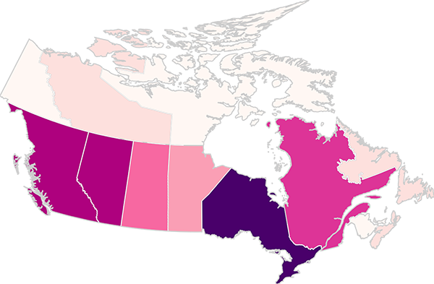


CANADIAN FUN FACT
Notes:
https://en.wikipedia.org/wiki/Poutine
“[…] french fries and cheese curds topped with a brown gravy […]”
“[…] emerged in Quebec in the late 1950s […]”
“[…] Several restaurants in the area claim to be the originators of the dish, but no consensus exists […]” → I already visited the Roy Jucep 2-3 times and I find it pretty good!

Slide 4
AGENDA
Power Platform Solution ALM
ALM Process in GitHub
Solution Deployment Automation
Branching strategies
Introduction to GitHub
Demonstration

Slide 5
Power Platform Solution ALM

Slide 6



Solution Deployment Automation
Export
Import
Export
Import
1. Detailed history of source code evolution
2. Automation of tasks related to the deployment of the solution
(ex: Solution checker, unit tests, security checks, static code analysis…)
3. Improvement of the organization of the development / configuration
with the use of branches and pull requests

Slide 7
Branching strategies
feature
feature
main
release

Slide 8
ALM Process in GitHub

Slide 9

Introduction to GitHub
Tasks & issues tracking
Source code management
Collaboration
Documentation
Project management
Automation
Notes:
“[…] Mascot
GitHub's mascot is an anthropomorphized "octocat" with five octopus-like arms. The character was created by graphic designer Simon Oxley as clip art to sell on iStock, a website that enables designers to market royalty-free digital images. GitHub became interested in Oxley's work after Twitter selected a bird that he designed for their own logo. The illustration GitHub chose was a character that Oxley had named Octopuss. Since GitHub wanted Octopuss for their logo (a use that the iStock license disallows), they negotiated with Oxley to buy exclusive rights to the image.
GitHub renamed Octopuss to Octocat, and trademarked the character along with the new name. Later, GitHub hired illustrator Cameron McEfee to adapt Octocat for different purposes on the website and promotional materials; McEfee and various GitHub users have since created hundreds of variations of the character, which are available on The Octodex. […]”

Slide 10
Demonstration
Issue assigned
Export & Unpack solution
Pull request created
Pull request
approved & merged
Issue closed
Branch creation
Quality checks
Environment provisioning
“Just in time environment”
Managed solution generation
Solution deployment (*)
Dev environment decommissioning
Solution import
Notification
Dev environment
Build environment
UAT environment
Dev environment
* For this step we will also need a “Just in time” build environment to generate the managed solution

Slide 11
Project to follow

Slide 12
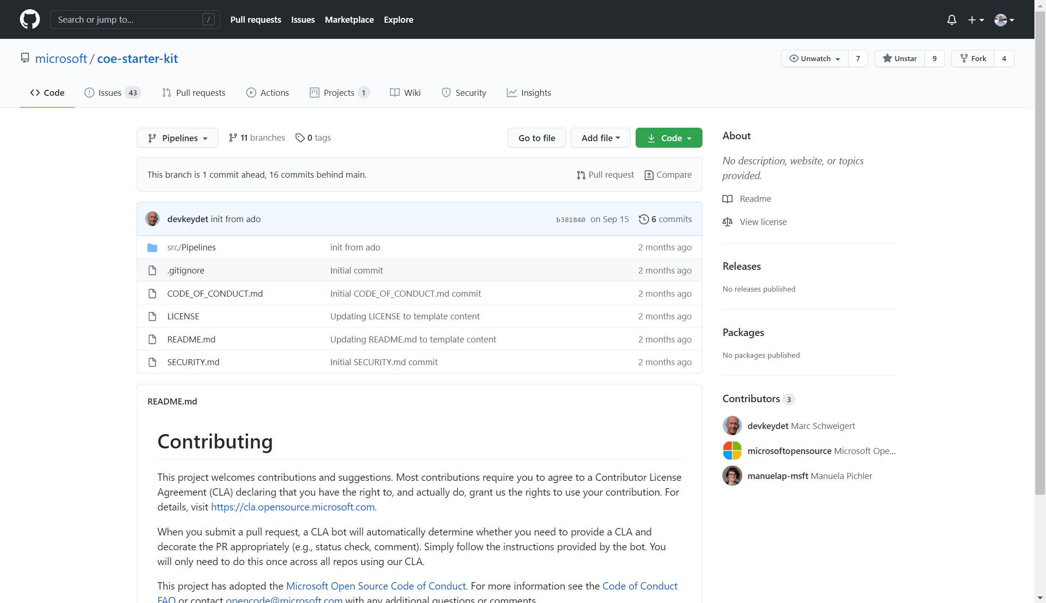


CoE Starter Kit (Pipelines)
Marc Schweigert
https://github.com/microsoft/coe-starter-kit

Slide 13

THANK YOU!
MAPLE POWER 2020
Fill out survey: https://bit.ly/2GEjUjr

